Slide 1
Basics of Hitting
Patriot Athletic League
Source: usabaseball.com

Slide 2
Stages of the Swing
Grip
1
Stance and Balance
2
Load
3
Stride
4
Swing
5
Contact Point
6
Finish
7

Slide 3
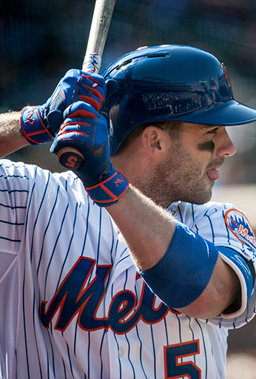
The Grip
For a right-handed batter, the left hand should be above the knob of the bat and the right hand should be above the left hand.
For a left-handed batter, the right hand should be above the knob of the bat and the left hand should be above the right hand.
There should be no space between the hands on the grip of the bat.
To grip the bat in the proper position in the hands, have hitters lay the bat handle at top of the palm where the fingers and palm meet, rather than deep in the palm.
The middle knuckles should be aligned for both hands.
The hitter’s back elbow, grip, hands, and upper body should remain relaxed and not tense.
Notes:
Coach Derek Shelton (Tampa Bay Rays):
We’re going to start out with the grip. The grip is one of the basic things with a swing. It can make a good swing bad and a bad swing good. So, what we’re going to try to do is make sure our knuckles line up. A real simple drill to do it is just lay the bat down like it’s a golf club, put the grip in, we’re going to have our knuckles lined up. If it’s not perfect, that’s fine. But what we really want to make sure of is that we don’t have the palm in here or the palm back in here because having the bat deep in our hands can cause a bad swing right off the bat. So, real simple grip. Try to line it up and try to stay loose.

Slide 4
Grip
Coach Derek Shelton (Tampa Bay Rays):
We’re going to start out with the grip. The grip is one of the basic things with a swing. It can make a good swing bad and a bad swing good. So, what we’re going to try to do is make sure our knuckles line up. A real simple drill to do it is just lay the bat down like it’s a golf club, put the grip in, we’re going to have our knuckles lined up. If it’s not perfect, that’s fine. But what we really want to make sure of is that we don’t have the palm in here or the palm back in here because having the bat deep in our hands can cause a bad swing right off the bat. So, real simple grip. Try to line it up and try to stay loose.

Slide 5
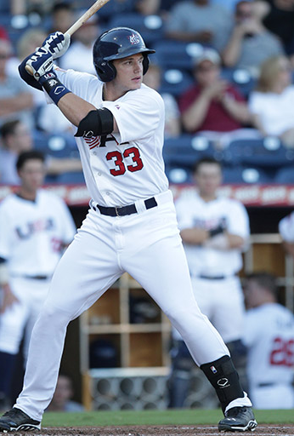
Stance and Balance
The fundamental basis of hitting mechanics is balance. Without balance, a productive swing is not achievable.
  The hitter’s base should be athletic and comfortable, and will vary from hitter to hitter.
  An athletic base is generally defined by having flexion in the knees and waist and the weight on the balls of the feet.
  Before starting the swing, the hitter's weight should be evenly distributed on both feet, and shoulders should be level.
  In the batter's box, hitters should stand close enough to home plate to be able to cover the outside corner of the plate while swinging.
Notes:
Coach Derek Shelton (Tampa Bay Rays):
The next thing we’re going to talk about is the stance. The one thing that people talk about in baseball is that baseball is not an athletic sport. That’s not true. A real simple drill that we can do for stance is to try to make sure that your weight stays inside your knees, you’re in a good position. It doesn’t matter how wide you are, how narrow you are. Everyone wants to say you have to be this way, this way. It’s not true. The one thing we want to make sure of, though, is that we have like nails through the middle of our shoes so we’re in this good, athletic stance. A real easy drill is to put your player in this stance right here, come up, put a little push in their chest. If they fall back, they’re not in a strong position. Good strong position, head over your body, making sure you stay stable within your feet.

Slide 6
Stance and Balance
Coach Derek Shelton (Tampa Bay Rays):
The next thing we’re going to talk about is the stance. The one thing that people talk about in baseball is that baseball is not an athletic sport. That’s not true. A real simple drill that we can do for stance is to try to make sure that your weight stays inside your knees, you’re in a good position. It doesn’t matter how wide you are, how narrow you are. Everyone wants to say you have to be this way, this way. It’s not true. The one thing we want to make sure of, though, is that we have like nails through the middle of our shoes so we’re in this good, athletic stance. A real easy drill is to put your player in this stance right here, come up, put a little push in their chest. If they fall back, they’re not in a strong position. Good strong position, head over your body, making sure you stay stable within your feet.

Slide 7
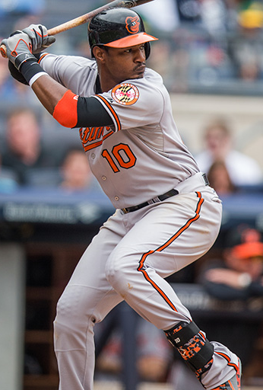
The Load
Every hitter will have a different load.
  To load in anticipation for a pitch, the hitter should shift some of their weight onto their back side.
  The hitter’s hands should also shift slightly back away from the ear, but should remain near the same level—not drastically dropping or raising.
  This shift in weight may cause the hitter’s shoulders to rotate. This movement is acceptable as long as it is a very slight rotation.
  Make sure the hitter’s head and eyes stay focused on the pitcher.
Notes:
Coach Derek Shelton (Tampa Bay Rays):
The next part of the swing we’re going to talk about is the load. Every hitter has a different load. The one thing, little kids, coaches, you have to be very conscious of is the fact that little guys are going to mimic what major league hitters do. Don’t do that. We’re going to give you a real simple drill for the load. Just throw the barrel of the bat, if you’re a right-handed hitter, down the first base side, throw the bat back. That position right there, that launch position, is where you should load from. So, it’s real easy to do. Everybody’s going to do it a little different. Barrel of the bat down the first base line, throw it back. From this position right here, that’s that strong loaded position that every hitter needs to get to release the barrel.

Slide 8
The Load
Coach Derek Shelton (Tampa Bay Rays):
The next part of the swing we’re going to talk about is the load. Every hitter has a different load. The one thing, little kids, coaches, you have to be very conscious of is the fact that little guys are going to mimic what major league hitters do. Don’t do that. We’re going to give you a real simple drill for the load. Just throw the barrel of the bat, if you’re a right-handed hitter, down the first base side, throw the bat back. That position right there, that launch position, is where you should load from. So, it’s real easy to do. Everybody’s going to do it a little different. Barrel of the bat down the first base line, throw it back. From this position right here, that’s that strong loaded position that every hitter needs to get to release the barrel.

Slide 9
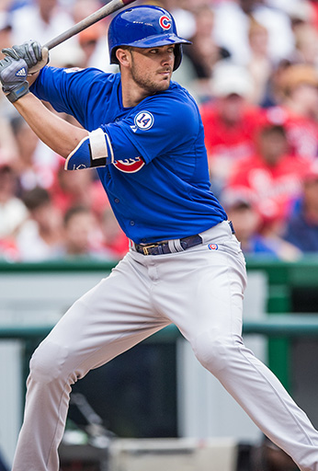
Stride and Separation
Simultaneous to the load occurring, the hitter will stride, which creates separation.
  The stride should be a small step forward with the hitter's front foot.
  When striding, the hitter's knees should stay slightly bent so that they are in an athletic position, and their weight should remain on the balls of their feet.
  The hands should remain in the load position during the stride, and there should be minimal movement of the head, shoulders, and arms.
  The hitter should remain balanced throughout the stride.

Slide 10
Stride and Separation
Coach Derek Shelton (Tampa Bay Rays):
Okay, the next thing we’re going to talk about with a basic swing is the stride. We talked about our stance, we talked about our load. Our stride is actually kind of part of our load. We want to make sure that when we stride, we stay on balance. Balance is one of the most important things of hitting. So, when you’re watching young hitters, you want to watch what we call “touchdown”: when the front foot hits the ground, if there’s balance. Your weight should never be forward, it should be either middle or a little bit back. If you find that you’re over-striding and getting out to your front side, out here when your weight’s out here, that’s too far. You’ll see some major league hitters that do that, but they have the ability to keep their hands back. But for young hitters, we want to make sure when we stride, we stay on balance with our weight at least 60% on the back knee.

Slide 11
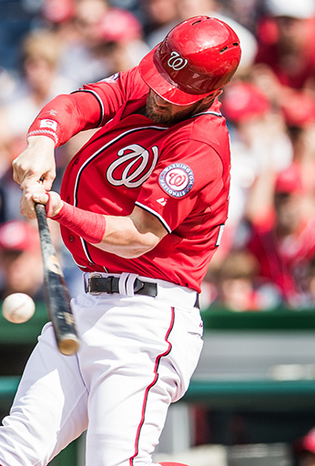
Contact Point (1 of 2)
Once the front foot has completed the stride, the swing can begin.
  The swing begins as the back hip rotates to drive the hands through the zone.
  As the back hip is rotating toward the ball, the back foot will pivot.
  The front foot should remain stationary as a brace for the swing, but allows the hips to rotate.
  The hands are pulled through the zone to hit the ball on a level plane.
  The hands and bat should go straight to the ball, creating a short swing. A short swing allows for quicker bat speed and better control of the bat.
  The hitter's weight should transfer from back foot to middle of the body.
Notes:
Okay, now we’re going to talk about contact point. One of the main things I want to talk about with contact point is it should happen in front of the plate. And what I mean by in front of the plate is in front of the white part. We will drill the ball being back on the plate for different things, but we want to make sure that when we contact the ball, regardless of where it’s at, it’s out in front of the plate. The one thing you have to be very careful with when you’re doing swing stuff off of a tee is that you don’t continually, for young kids, move the tee back on the plate because you’re creating a bad contact point. If we’re going to get maximum impact on the ball, we’re going to want to make sure we contact the ball out in front of us so we can get the ball in the right spot. So, we can drill it where the ball comes back, but in the game we’re going to watch for that contact point to be in front of the plate for maximum impact.

Slide 12
Contact Point (2 of 2)
The contact point is the location in the swing in which the ball is hit.
The hitter's head should remain fixed with eyes on the ball at all times.
In general, the contact point is in front of the plate for maximum impact on the ball.
There are three main contact points:
  Inside: In general, a pitch in this location should be hit to the pull-side of the field for the hitter or back up the middle of the field.
  Middle: In general, a pitch in this location should be hit back up the middle of the field.
  Outside: In general, a pitch in this location should be hit to the opposite field for the hitter.

Slide 13
Contact point
Coach Derek Shelton (Tampa Bay Rays):
Okay, now we’re going to talk about contact point. One of the main things I want to talk about with contact point is it should happen in front of the plate. And what I mean by in front of the plate is in front of the white part. We will drill the ball being back on the plate for different things, but we want to make sure that when we contact the ball, regardless of where it’s at, it’s out in front of the plate. The one thing you have to be very careful with when you’re doing swing stuff off of a tee is that you don’t continually, for young kids, move the tee back on the plate because you’re creating a bad contact point. If we’re going to get maximum impact on the ball, we’re going to want to make sure we contact the ball out in front of us so we can get the ball in the right spot. So, we can drill it where the ball comes back, but in the game we’re going to watch for that contact point to be in front of the plate for maximum impact.

Slide 14
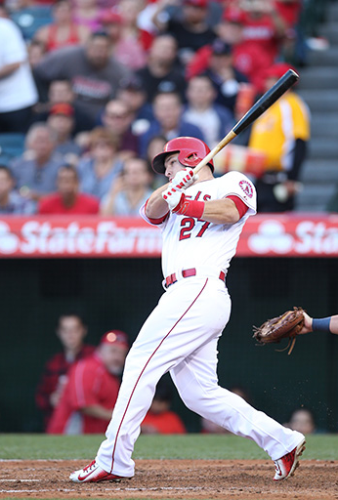
The Finish
The finish of the swing allows for all of the force generated to be used.
Once the hitter has made contact with the ball, they should finish their swing.
The hands should continue around the front side of the body with arms extended.
  This can be achieved with both hands remaining on the bat or the top hand coming off of the bat after contact has been made.
The hips and torso should continue to rotate to allow the hands to follow through.
The head and eyes should still be focused on the point of contact.
  If the hitter is looking at where they hit the ball, have them refocus on the point of contact for their next swing.
The hitter should be balanced throughout the entire finish.
  If they are unbalanced, check their stride direction.
Notes:
Coach Derek Shelton (Tampa Bay Rays):
Okay, the last thing we’re going to talk about is the finish of the swing. Now the finish of the swing should happen naturally. Some people are going to tell you to do it with one hand; some people are going to tell you to do it with two hands. It’s kind of a personal preference or what your swing feels best with. The one thing, and the most important thing just like everything throughout the swing, is that when we finish the swing, we want to make sure we’re balanced. If we’re in that good, strong, balanced position, everything else that’s happened before that probably happened in the right succession. If we find ourselves off-balance this way or coming towards the plate, something broke down in the timing of the swing. So, we just need to make sure when we finish that swing, we stay in a good, balanced position. A really good way to do this is drill it and hold the trophy stance to make sure the finish is good.

Slide 15
The Finish
Coach Derek Shelton (Tampa Bay Rays):
Okay, the last thing we’re going to talk about is the finish of the swing. Now the finish of the swing should happen naturally. Some people are going to tell you to do it with one hand; some people are going to tell you to do it with two hands. It’s kind of a personal preference or what your swing feels best with. The one thing, and the most important thing just like everything throughout the swing, is that when we finish the swing, we want to make sure we’re balanced. If we’re in that good, strong, balanced position, everything else that’s happened before that probably happened in the right succession. If we find ourselves off-balance this way or coming towards the plate, something broke down in the timing of the swing. So, we just need to make sure when we finish that swing, we stay in a good, balanced position. A really good way to do this is drill it and hold the trophy stance to make sure the finish is good.

Slide 16
Pre Pitch Preparation for Hitters
Mental Routines
Physical Routines
BEFORE THE GAME
  Find out who will be pitching
  Visualize hitting their pitches
  Watch the pitcher warming up to look for movement and point of pitch
IN THE DUGOUT
  Watch the pitcher
  Talk to the previous batters
  Look for patterns
  Look for signals and anything the pitcher does when throwing different pitches
ON DECK
  Formulate a plan for the at-bat
  Know the situation
  Anticipate the pitches
  Keep emotions under control
ON THE WAY TO THE PLATE
  Have a positive attitude
  Believe your preparation will pay off
  Have no doubts in your abilities
ON DECK
  Relax
  Achieve synchronization with the pitcher
  See the point of release and follow the ball
  Focus on the early load (start before the point of release)
  Breathe
BATTER'S BOX
  Use the same routine for every pitch
  Clear the mind (clear all thoughts after each pitch)
  Automatic Pilot (let the eyes take over)
  Trust yourself
  Remember to breathe
As a coach, you should recognize the alert signs of each batter and help them focus on positive thoughts if they begin to doubt themselves.
In-game teaching is about positive reinforcement, never more so than with your hitters.

Slide 18
Beginner BATTING PRACTICE example
It is ideal to have at least one coach at each station during BP. However, some stations such as the tee and cage stations can be managed by players feeding the other players in their group. For maximum productivity, try to keep the groups small, perhaps 4 - 5 players each. Each station rotates to the next numerical station. Station 3 will rotate to station 1.
Defensive Station
  Players should be in the infield and outfield positions fielding the balls being hit by the live hitting group
  A bucket can be placed in the outfield for easy ball pick-up
  Make sure your players pay attention and watch the hitter at all times. Avoid allowing your players to stand in groups
Skill Station
  Skill stations should have tees and baseballs
  Players should work on hitting the ball off of the tee and driving the ball back up the middle
  Depending on the number of tees available, the group can be split into smaller tee groups
  A coach should be present at this station to monitor for safety
Live Hitting Station
  Set up a front toss screen on the field and have a coach throw front toss to the hitters
  Players next in line to hit should be warming up in the on deck circle. All other players waiting their turn to hit should be in the dugout
  Each hitter should get at least 10 swings off of front toss on the field
  On the last swing of their turn, have the players run through first base, then rotate back into the dugout to wait for another turn to hit
OPTIONAL HITTING ROUTINES
The following hitting routine provides hitting situations that can be performed during batting practice, and the suggested repetition for each situation.
SITUATIONAL ROUTINE
Sacrifice bunt- 5
Hit and run- 3
Opposite field- 3
Up the middle- 3
Regular swings- 5
In instances where more coaches are available, additional stations can be created. Please reference the "Advanced BP Routine" document for adding more stations to your BP routine.

